Slide 1
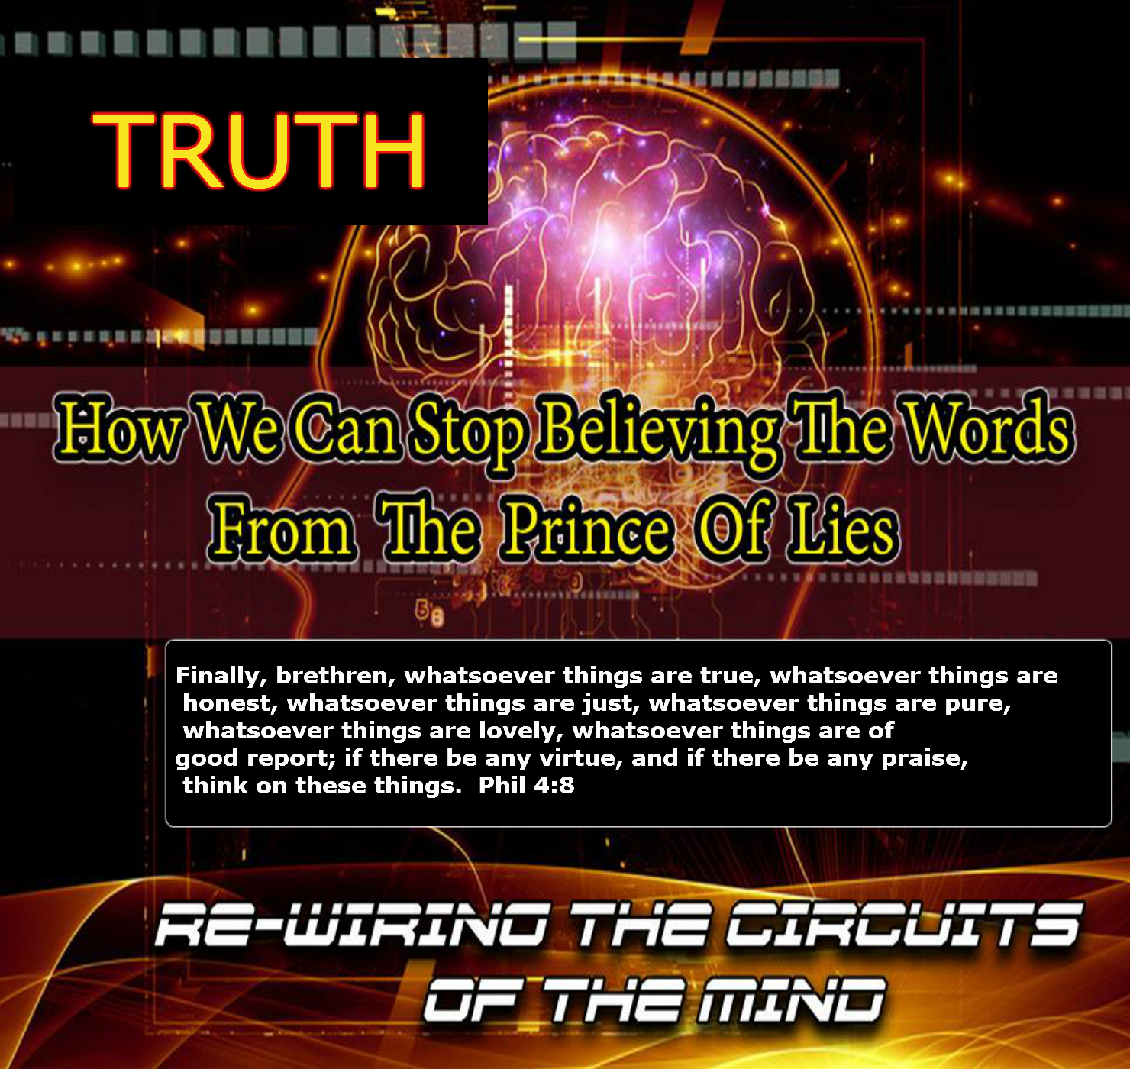

Slide 2
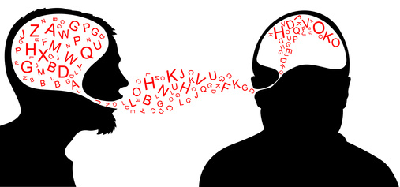
It Begins In Childhood

Slide 3
Introduction
From our earliest stages in life, we are bombarded with lies…from the moment we are born and that person says, what a cute baby, when deep down they want to gag…to when you become CEO of a company and are surrounded by yes men and women….to the day you die when your ears would burn if they could, listening to the lies…..But….

Slide 4
INTRODUCTION
…the greatest lies are the ones we hear from ourselves and Satan…The Father of lies. In this study we will examine a few of those lies and the way to combat them. If you were not on the study line when we did this…then prepare to hear some new thoughts concerning the mind…if you were on…this study will expand on what we looked at back then!!!!

Slide 5
Some of those lies
You Are Worthless And Will Never Amount To Anything In Life
You Have To Do It The Right Way (The Way That I Do It)
If You Want To Be Somebody You Have To Go To This Particular School
If You Want To Get The Best Jobs, You Must Have A Master’s Degree

Slide 6
Some of those lies…
I Am Too (Fat/Skinny/Short/Tall/Dumb/Weird)
I Can’t…..
Who’d Ever Want To Marry Me
I’m Too Old To Change
I’m Too Young To Matter
No Matter How Hard I Try I Will Always Fail
I Will Never Be Perfect….Won’t Bother Trying

Slide 7
Before we go further…
“For as he thinketh in his heart, so is he…” Prov.23:7
“Keep thy heart with all diligence; for out of it are the issues of life.” Prov. 4:23
“For out of the heart proceed evil thoughts, murders, adulteries, fornications, thefts, false witness, blasphemies:” Matt.15:19

Slide 8
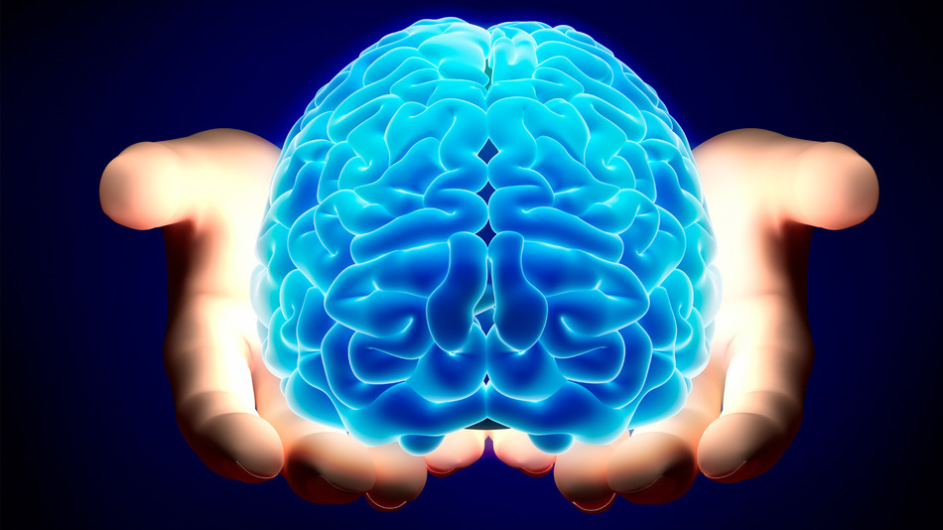
Picture Of The Brain

Slide 9

Picture Of The Mind

Slide 10
What is the mind?
MIND
noun
1. the element of a person that enables them to be aware of the world and their experiences, to think, and to feel; the faculty of consciousness and thought:
"as the thoughts ran through his mind, he came to a conclusion“
synonyms:
brain, intelligence, intellect, intellectual capabilities, brains, brainpower, wits, understanding, reasoning, judgment, sense, head, gray matter, brain cells, smarts, sanity, mental faculties, senses, wits, reason, reasoning, judgment, marbles

Slide 11
SO In Our study….
We are NOT focusing on bio-chemical restructuring of the brain, but in a practical way, leaping forward in our understanding of principles that should have taken root a while back

Slide 12
Principle Number 1
Positive Thinking/Speaking:
“Cultivate the habit of speaking well of others. Dwell upon the good qualities of those with whom you associate and see as little as possible of their errors and failings.”
(Ministry and Healing, 491)

Slide 13
How Does One Cultivate A Habit?

Slide 14
Principle Number 2
Garbage Dump:
And they that are Christ's have crucified the flesh with the affections and lusts.
---Gal.5:24

Slide 15
Basics
Do NOT Listen To Negative Things: Psalms 1:1
Do Not Watch Negative Things: Psalms 103:1
Be Careful What Is Allowed To Swirl Around In Your Mind: Philippians 4:8

Slide 16
Principle Number 3
Mind-Set
Set your affection on things above, not on things on the earth. Col.3:2
Note: This is perhaps most notably emphasized in the following quotes:

Slide 17
Law Of The Mind
It is a law of the human mind that by beholding we become changed. Man will rise no higher than his conceptions of truth, purity, or holiness (PP 91).
It is a law of the mind that it gradually adapts itself to the subjects upon which it is trained to dwell. . . . If never required to grapple with difficult problems, it will after a time almost lose the powers of growth (PP 596).
It is a law of the mind that the mind narrow or expands to dimensions of things with which it becomes familiar (CT460, FE 127, MYP 262).
If the mind is allowed to run almost entirely upon trifling things and the common business of everyday life, it will, in accordance with one of its unvarying laws, become weak and frivolous, and deficient in spiritual power. (5T 272).

Slide 18
You are worthless and will never amount to anything In life
“I will make a man more precious than fine gold; even a man than the golden wedge of Ophir” Isa.13:12

Slide 20
You have to do it the “right” Way
But the anointing which ye have received of him abideth in you, and ye need not that any man teach you: but as the same anointing teacheth you of all things, and is truth, and is no lie, and even as it hath taught you, ye shall abide in him.
1 John 2:27
And thine ears shall hear a word behind thee, saying, This is the way, walk ye in it, when ye turn to the right hand, and when ye turn to the left. Isa. 30:21

Slide 22
I Can’t

Slide 24
Final tips

Slide 25
Final thoughts
We've all had them....negative thoughts implanted into the mind, but we don't have to keep them there....our final Scripture reading proves this:
2Corinthians 10:3-5
Note: Though we walk in flesh, among it,etc. we do not have to operate according to its dictates...in fact we are emphatatically told...cast down those thoughts....and whatsover is true....think on these things. Amen

